Slide 1
TRANSNET SOC LTD
WESGRO INSIGHTS: NAVIGATING A COVID-19 WORLD
Transnet Group Chief Executive
Portia Derby
02/06/2020

Slide 2
CONTENTS
Economic Overview:
The Great Depression vs the Great Lockdown
The Great Lockdown: An economic anomaly
2. Distorted supply chains as a result of COVID19
Negative impact on international trade
Impact on the South African economy
Domestic growth: the catalyst for economic growth
3. Transnet SOC Ltd uniquely positioned to benefit from growth
Transnet projects in the Western Cape
4. Our Response to COVID-19

Slide 3
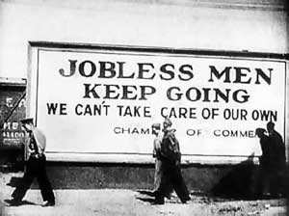

The Great Depression vs the Great Lockdown
For the first time since the Great Depression both advanced economies, emerging market and developing economies are in recession.
The Great Depression, 1930s
The Great Lockdown, 2020
Sources: US Forbes Magazine. 2020; University System of Georgia, 1930s

Slide 4
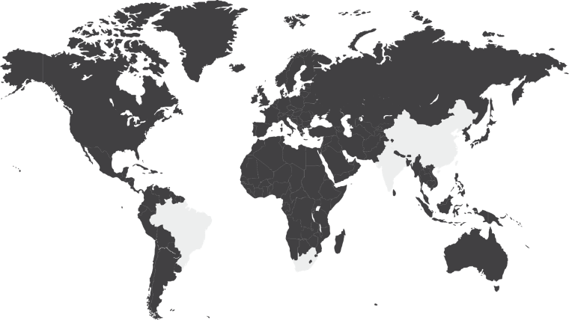
The Great Lockdown: an economic anomaly
Figure 1: Real GDP, annual percent change, 2020 -2021
Figure 2: Low global growth as a result of COVID-19 pandemic,2020
Real annual % change | 2019 Actual | 2020 Forecast | 2021 Forecast
Advanced Economies | 1.7 | -6.1 | 4.5
United States | 2.3 | -5.9 | 4.7
Euro Area | 1.2 | -7.5 | 4.7
Japan | 0.7 | -5.2 | 3.0
United Kingdom | 1.4 | -6.5 | 4.0
Emerging and Developing Economies | 3.7 | -1.0 | 6.6
China | 6.1 | 1.2 | 9.2
India | 4.2 | 1.9 | 7.4
Russia | 1.3 | -5.5 | 3.5
Brazil | 1.1 | -5.3 | 2.9
South Africa | 0.2 | -5.8 | 4.0
World Trade Volumes | 1.5 | -11.0 | 8.4
Imports
- Advanced Economies | 1.5 | -11.5 | 7.5
- Emerging and Developing Economies | -0.8 | -8.2 | 9.1
Exports
- Advanced Economies | 1.2 | -12.8 | 7.4
- Emerging and Developing Economies | 0.8 | -9.6 | 11.0
ASIA: Reduced working hours will negatively impact the economy. Economic output relies on the demand of raw material and intermediate goods. This growth is expected to remain significantly muted in the long-term.
US: Nearly 40 million jobs are expected to be lost. Economists estimate that 40% of the population will be unemployed in the long-term.
TRADE VOLUMES: expected to decline by -11.0% in 2020
Sources: International Monetary Fund: World Economic Outlook, 2020; US Bureau of Labour Statistics, 2020; International Labour Organisation, 2020.

Slide 5
Supply chains will be distorted as a result of the pandemic
Commodities
Intermediate Goods
Final Goods
Storage
Warehouse
DC
Raw materials
Manufacturing & Assembly
1
2
Distribution
3
Market
Propagation
Backpropagation
Supply shocks
Distribution constraints
Demand shocks
Trade restrictions
Closing of facilities
Clogged distribution systems
Hoarding
Drop in demand
Substitution (drop in pattern)
Lack of raw materials
Lack of parts
Reduced jobs opportunities
Source: Adapted from Transportation and Pandemics, University of Minnesota, 2020
Notes:
The global economy has been favored by the exploitation of comparative advantages and more tight management of supply chains. It is consequently difficult to assess the impacts of a pandemic on supply chains because of the variety of actors, locations, modes, terminals, and distribution centers involved in each.
Supply chains are also specialized and fragmented, implying that if the demand changes in one sector, other related sectors are not necessarily able to adjust. This is particularly the case between commercial and consumer demand. For instance, food supply chains are usually divided between groceries, institutional and restaurant providers. If during a quarantine a large share of the population does not work and commute, commercial demand will drop while consumer demand will rise.
Supply chains may not be able to respond to the switch in the demand pattern, even if the aggregate demand remains similar. Shifting supply chain channels requires new interactions between actors that did not interact beforehand. Further, the origins, destinations, modes of transportation, and even the packaging and shipping of the cargo have to be modified.
Pandemics impacts supply chains over two dimensions:
Supply shocks. An unexpected sudden change in the availability of raw materials, parts, goods, and manufacturing capabilities. It is usually accompanied by price surges, but the availability of essential components can be undermined because of a lack of raw materials, parts, or the lack of labor necessary for their procurement.
Demand shocks. Demand shocks imply a sudden change in demand due to unforeseen circumstances. For items such as food, hoarding may trigger a temporary surge in the demand with several items becoming unavailable. In other sectors such as energy, the demand may drop substantially because of declines in commuting and travel.
The transportation industry has consolidated into a small number of global and national mega-players to achieve massive economies of scale. This is the case for the two most important global freight transportation modes; maritime shipping and air cargo.
Since the frequency, speed, and reliability of shipments are high under normal circumstances, manufacturers have relocated their facilities to lower-cost locations. Because transportation costs are lower than inventory management costs, retailers and secondary manufacturers employ just-in-time inventory systems – their stockpile is flowing in the transportation stream as inventory in transit. Most supply chains are re-stocked on a continuous basis, on par with the demand, which is labeled pull logistics. (Rodrigue,J.D., Luke, T., & Osterholm, M. 2020. Transportation and pandemics. University of Minnesota)

Slide 6
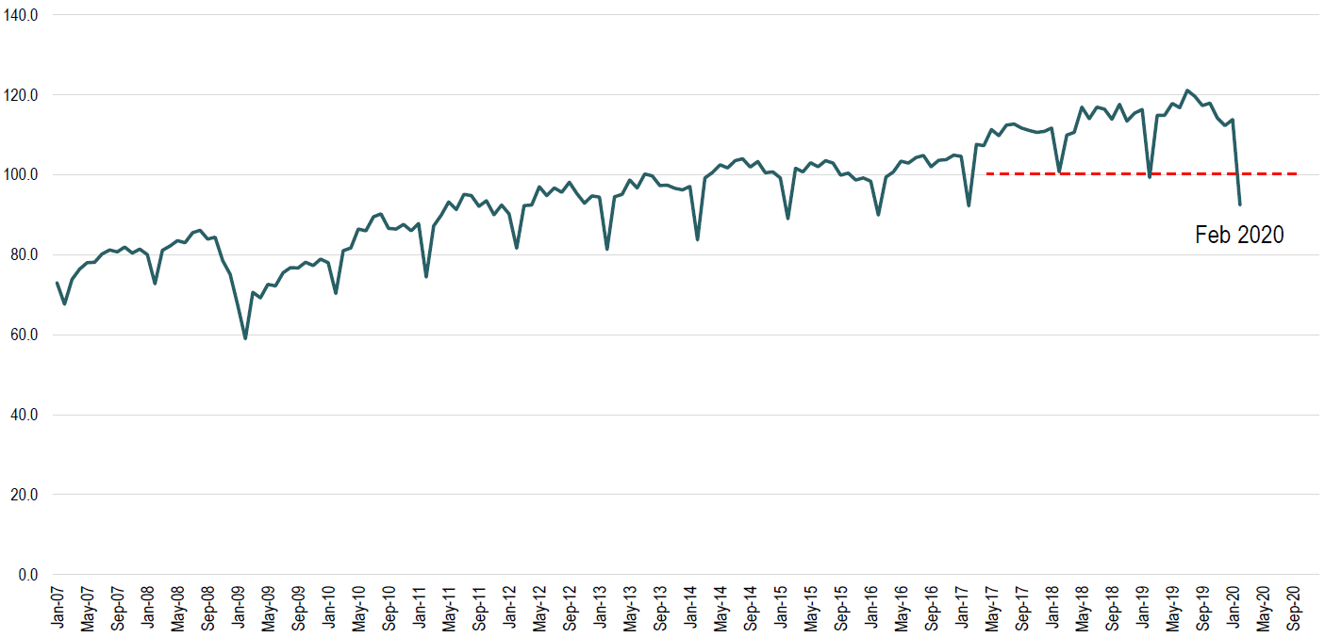
International trade will be negatively impacted
The container throughput in ports is an important indicator of global trade. Almost all value-added goods are transported through containers, with total shipping is largely made up of oil, coal, ore etc
Figure 3: RWI/ISL Container Throughput Index, 2007-2020 (2015 = 100)
Source: Adapted from Transportation and Pandemics, University of Minnesota, 2020

Slide 7
Transportation and Agricultural sectors the worst performers in the last 2 years
Figure 4: Sectoral contribution to GDP pre-COVID19, Q4 2019 (%)
All three sectors of the economy experienced negative growth.
Primary sector: -0,4% (Mining, Agriculture, forestry & fishing.
Secondary sector: -2,9% (Manufacturing, Electricity, gas and water, Construction).
Tertiary sector: -1,0% (Trade, Transport & communication, Finance, Government, Personal services)
Source: Statistics South Africa, March 2020

Slide 8
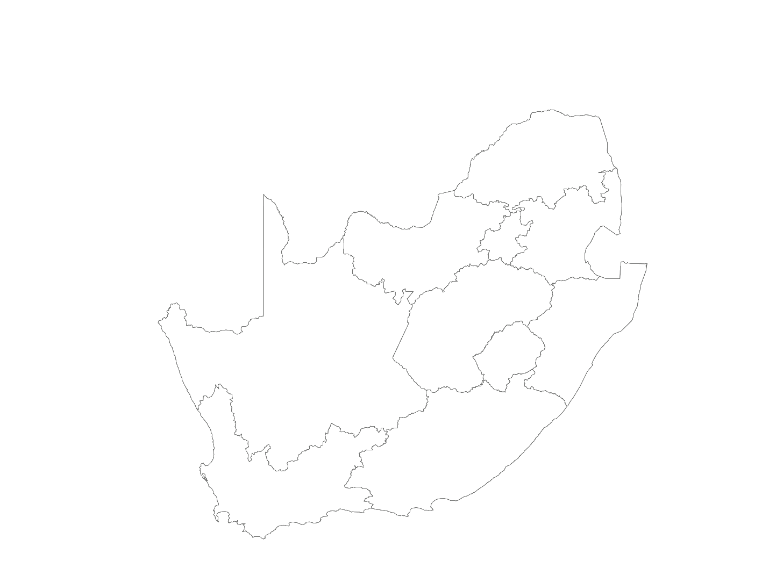






Transnet is uniquely positioned to support the economy, providing reliable freight, transport and services
Figure 5: Volume estimates pre-COVID19, 2019
Volume Estimates (mt)
COMMODITY | 2019/20 | 2020/21
Coal Exports | 72, 0 | 74,4
Iron Ore | 59,7 | 59
Manganese | 14,78 | 15,55
Magnetite | 9,5 | 13,8
Eskom Coal | 7,5 | 11,08
Chrome | 7 | 10.5
Domestic Coal | 7,7 | 9,56
Total | 178,18 | 193,89
Ports Terminals
Beitbridge
Ports Authority
Johannesburg
Corporate Centre
Freight Rail
Koedoespoort
Engineering
Pipeline
Germiston
Sishen
Richards Bay
Bloemfontein
Durban
Saldanha
Salt River
East London
Cape Town
Ngqura
Mossel Bay
Port Elizabeth
Sources: Transnet Internal, 2020; South African Minerals Council, 2019

Slide 9
Domestic markets: catalyst for economic growth in post-COVID era?
Increase in transport cost and a retraction of supply chains could induce substitution between domestic and imported commodities. This has the potential to benefit the domestic economy.
Figure 6: South Africa’s exports and imports from Jan – Apr 2019 to Jan –Apr 2020*
PERIOD | JAN to APR 2019/JAN to APR 2020
World Zone | EXPORTS |  |  | IMPORTS
 | January to April 2019 | January to April 2020 | % increase/decrease | January to April 2019 | January to April 2020 | % increase/decrease
 | Rm | Rm |  | Rm | Rm
Africa | 105 181.2 | 92 127.9 | -12.4% | 47 635.6 | 47 912.1 | 0.6%
America | 33 795.0 | 33 919.5 | 0.4% | 38 574.7 | 37 502.1 | -2.8%
Asia | 126 631.2 | 121 643.5 | -3.9% | 182 117.2 | 168 332.8 | -7.6%
Europe | 103 587.7 | 99 657.0 | -3.8% | 127 342.9 | 121 938.0 | -4.2%
Oceania | 3 972.5 | 3 387.3 | -14.7% | 6 487.2 | 4 941.6 | -23.8%
Other unclassified | 20 283.8 | 27 251.1 | 34.3% | 1 426.5 | 781.2 | -45.2%
Ship/Aircraft | 1 267.6 | 3 076.6 | 142.7% | - | - | 0.0%
Total | 394 719.1 | 381 080.9 | -3.5% | 403 584.1 | 381 407.8 | -5.5%
Sources: South African Revenue Services, 2020 ; UNCTAD Handbook of Statistics, 2020; General Administration of Customs, 2020;
Notes:
*NOTE: Export and import figures are unaudited figures obtained from declarations made by exporters and importers of goods. The figures cover all goods exported and imported during the reporting month from and to South Africa. Cursory checks of the figures are made prior to publication thereof, to try and eliminate as many capturing errors as possible.

Slide 10
2020/21 Western Cape Capital Budget (R’m)
Figure 7: Western Cape capital budget, 2020
Significant investment expected for Saldhana IOT
  3,044
2,129
1,025
  2020/21
  2021/22
  2022/23
  2023/24
  2024/25
  Total
  Cape Town CT
  Cape Town MPT
Sources: Transnet Internal, 2020.
  Saldanha MPT
  88.0%
  Saldanha IOT
Notes:
NOTE: Importance of local procurement as a stimulus measure and for industrialization.

Slide 11
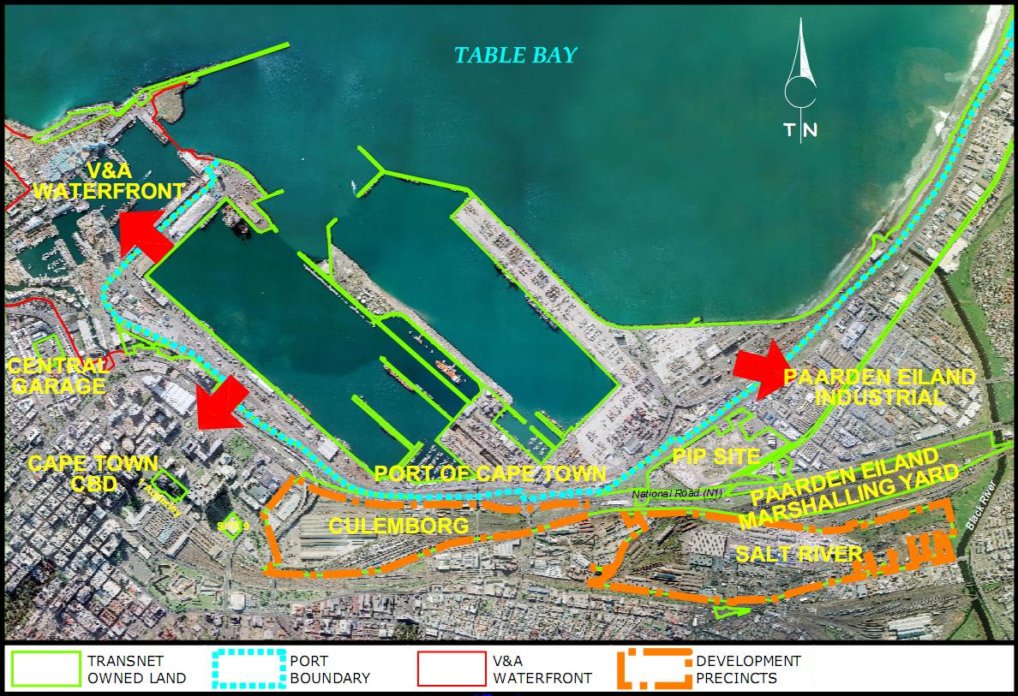
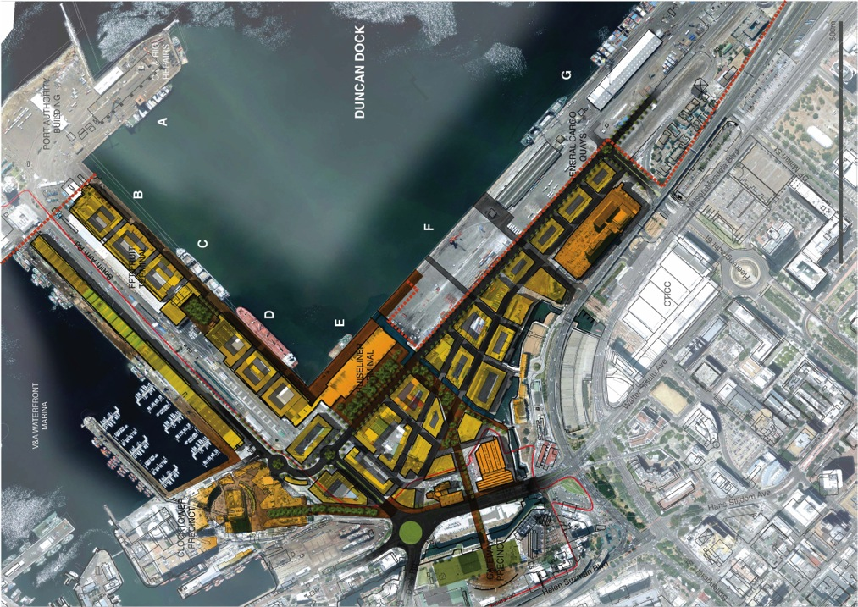
Transnet Projects in the Western Cape
Project examples
Culemborg Spatial Development Framework
Belcon (or Kraaicon) inland facility
Yacht club relocation
Road-to-Rail modal shift
Port Gateway Precinct
Cape Town Container Expansion Project Phase 2 B about R1.5 billion
Installation of a Third Tippler and Related Infrastructure at the Bulk Terminal, Port of Saldanha about R3.5 billion
Aerial view of Table Bay
Sources: Western Cape Government, 2020

Slide 12

Transnet’s Response to COVID: Western Cape Scenario
23 Mar 2020
RSA National Lockdown Announced, in effect 26 March 2020
30 April 2020
RSA National Lockdown moved to Level 4
11 Mar 2020
WHO declares Global Pandemic
Immediate Impact Horizon
Tactical Horizon
Strategic Horizon
Brace Period
Embedding the “New Normal”
Optimisation & Durability
Creating the New Normal
24 Mar 2020
Transnet COVID-19 response escalated, programme team established.
The immediate period represents an extremely agile and proactive period to support the national imperatives while protecting and supporting employees and the business.
This is an extreme change from business as usual.
Preparation underway for the “New Normal”
As the crisis has unfolded, lessons have been learned and new ways of working have evolved.
Relative stability in the environment has given Transnet the opportunity to go through the process of codifying these into a new way of working, based on an estimated ~18 month impact window for the CoVid-19 virus.
15 Mar 2020
RSA declares State of Disaster
Jan 2020
COVID Task Team Established, war room set up
Initial focus on communication, education, doing risk assessments, readiness plans
Business preparedness processes undertaken (emergency procurement of hygiene supplies, testing of BCP etc.)
Ramp-up of response
Source: Transnet internal, 2020

Slide 13
TRANSNET KEY PILLARS
1
2
3
4
5
Customer Service
People
Asset Utilisation
Safety
Cost Control

Slide 14
THANK YOU,
NGIYABONGA
Transnet SOC Ltd
9 Country Estate Drive
Waterfall Business Estate
Midrand, 1662
+ 27 (11) 308 2313
Portia.Derby@Transnet.net

